Slide 1
SEMINAIRES DU CREG / 2019-2020
Proposals for an institutionalist reform
of financial regulation
Faruk ÜLGEN
24 octobre 2019, 14h15-16h15, Salle EG03, BATEG, Campus SMH
CenteR Of research in economics of Grenoble (CREG)
Grenoble Faculty of Economics – Univ. Grenoble Alpes – France

Slide 2
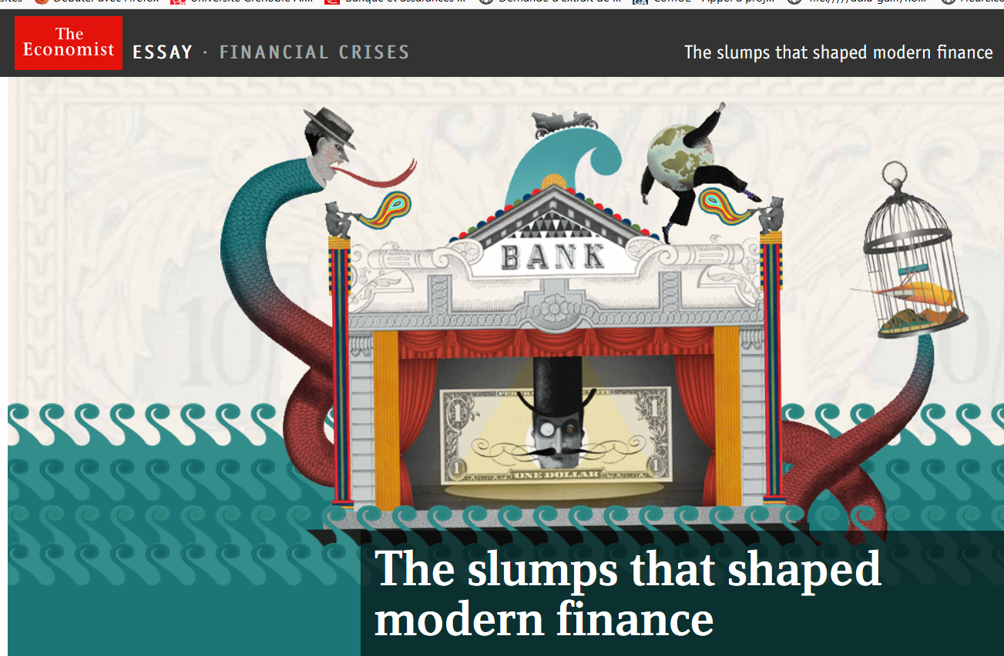
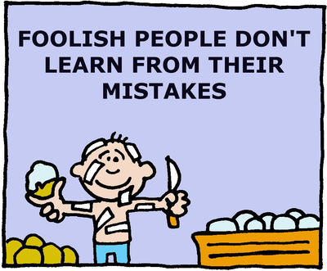
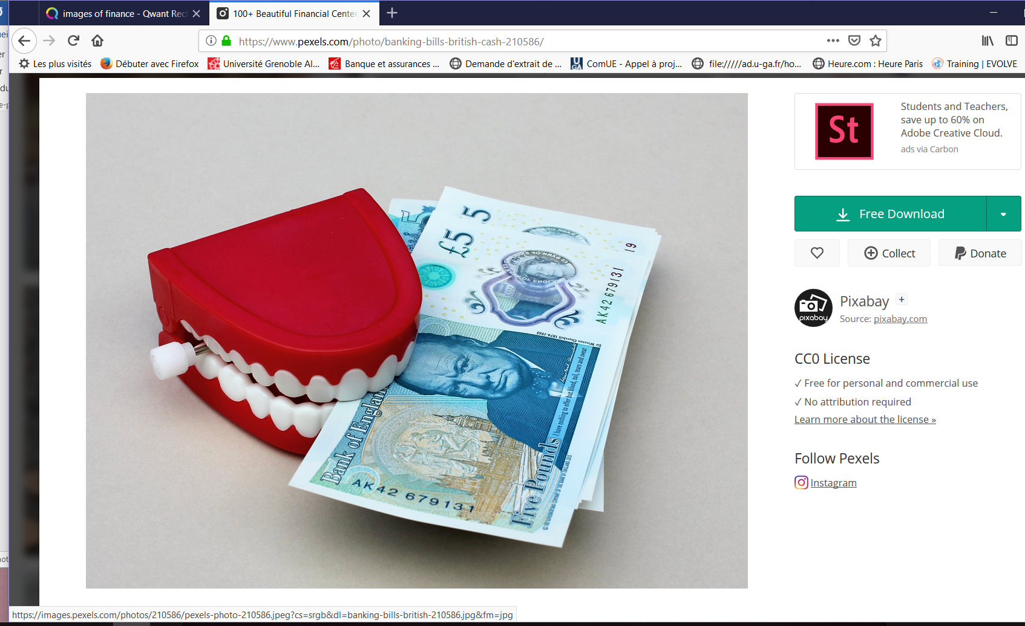
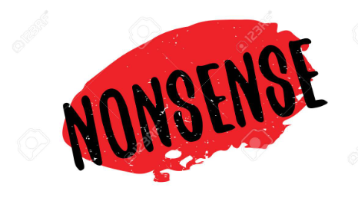
BORROWED FROM: https://www.pexels.com/photo/banking-bills-british-cash-210586/

Slide 3
WORK PLAN
Financialization: some unpleasant observations
Monetary economy paradox: Finance as a double-edged sword
An alternative financial regulation framework

Slide 4
Financialization: some unpleasant observations
* Observations:
Recurrent crises of financialized economies since the 1990s raise doubts about the ability of the liberalized financial markets to allow economies to evolve on a sustainable (and stable?) macroeconomic path.
* Context:
Financialization of economies enlarged and increased uncertainties that have huge impacts on the final (mal)adjustment of economic imbalances.

Slide 5
Dominant beliefs in support of financialization : In its Global Financial Stability Report (GFSR) of April 2006, the IMF argues that structural changes have made financial intermediaries much stronger: “The positive assessment contained in the September 2005 GFSR that “the global financial system has yet again gathered strength and resilience” has been validated by recent developments.” (p. 1). Innovative finance “derisked” the banking sector (Ibid) (Evidence (see following chart): banks’ net income increasing and nonperforming loans decreasing ) Greenspan (2005) also argued that: “increasingly complex financial instruments have contributed to the development of a far more flexible, efficient, and hence resilient financial system than the one that existed just a quarter-century ago”.

Slide 7
If these facts do not provide authorities with relevant information about the soundness of the financial system,
Then What alternative analysis?
➔Focusing on the monetary characteristics of a capitalist economy
➔Drawing upon the institutionalist understanding of how a capitalist economy operates (financialization and systemic INstability)

Slide 8
2. Monetary economy paradox: Finance as a double-edged sword
WHAT IS MONEY?
A DECENTRALIZED AND INDIVIDUAL DECISIONS-BASED ECONOMY works through a PAYMENTS SYSTEM
Which is A SET OF RULES, MECHANISMS, LAWS, INSTITUTIONS (PUBLIC/PRIVATE) WHICH GOVERN THE PROCESS OF:
CREATION/ISSUANCE;
CIRCULATION/TERMS OF USE;
ANNULMENT (REIMBURSEMENT/REPAYMENT) OF PRIVATE DEBTS

Slide 9
➔ THOSE DEBTS COME FROM THE FINANCING PROCESS OF ENTREPRENEURIAL EXPECTATIONS (mainly) BY BANK CREDIT
THEY CONTINUOUSLY FLOW INTO THE ENTIRE ECONOMY AS GENERAL MEANS OF PAYMENT AND SETTLEMENT:
i.e. AS MONEY WITH GENERAL PURCHASING AND DEBT-SETTLEMENT POWER (SOCIETY-WIDE ACCEPTANCE/USE)
HENCE MONEY APPEARS TO BE A SOCIAL INSTITUTION BUT AT THE SAME TIME IT RELIES ON PRIVATE (DEBT) OPERATIONS SINCE IT mainly COMES INTO THE PICTURE THROUGH THE PRIVATE FINANCING PROCESS.

Slide 10
THEREFORE MONEY IS AMBIVALENT AND TRANSVERSAL …
→ Ambivalent:
Money is a private creation (individual, decentralized, private decision and action system);
BUT at the same time,
Money has a pure public character (Money is also THE general means of settlement).
→ Transversal:
Everything and everyone are everywhere directly/indirectly involved in monetary (debt) relations and then affected more or less by the evolution of money and financial markets.

Slide 11
… AND Finance is a double-edged sword
→ Capitalist accumulation needs finance (bank credit, financial markets funding)
But at the same time when financial markets become free of any related real economy need and inflate through a speculative expansion of returns, capitalism collapses.
“First, the growth of a country's financial system is a drag on productivity growth. That is, higher growth in the financial sector reduces real growth. In other words, financial booms are not, in general, growth-enhancing, likely because the financial sector competes with the rest of the economy for resources. Second, …credit booms harm what we normally think of as the engines for growth – those that are more R&D intensive. …there is a pressing need to reassess the relationship of finance and real growth in modern economic systems.” (Cecchetti and Kharroubi, 2015: 24).
See Figure below (Ibid, p.2)

Slide 13
Unfortunately, this has not been admitted before the 2007-2008 world-wide turmoil since the system-makers did repeatedly asserted the advantages of free financial markets. Policies implemented from the late 1970s resulted in a generalized financialization: * The ascendancy of shareholder value, … dominance of market-based financial systems over bank-based financial systems (Epstein, 2006) * "the increasing dominance of the finance industry in the sum total of economic activity, of financial controllers in the management of corporations, of financial assets among total assets, of marketised securities and particularly equities among financial assets, of the stock market as a market for corporate control in determining corporate strategies…" (Dore, 2002)

Slide 14
3. How to deal with the recurrent instabilities? An alternative financial regulation framework
A complex issue:
→ An alternative regulation: how to design and implement it in a global economy somewhat controlled by large multinational financial firms that regards financial regulation as a set of constraints and restrictions and not as a relevant framework that would let them adopt healthy strategies in order to get back sustainable outcomes through time?
→Good institutions: The issue is also related to the design of good (relevant) institutions that would be consistent with the characteristics and prerequisites of a given economic and financial system.

Slide 15
Institutions:
“… are the rules of the game of society or, more formally, the humanly devised constraints that shape human interactions. [ . . . ] Institutions reduce uncertainty by providing a structure to everyday life. They are a guide to human interaction, so that when we wish to greet friends on the street, drive an automobile, buy oranges, borrow money, form a business, bury our dead, or whatever, we know (or can learn easily) how to perform these tasks. (Douglas North, 1990: 3–4).
“Economic institutions determine the incentives of and the constraints on economic actors, and shape economic outcomes. As such, they are social decisions, chosen for their consequences. Because different groups and individuals typically benefit from different economic institutions, there is generally a conflict over these social choices, ultimately resolved in favor of groups with greater political power.” (Acemoglu et al. 2005: 386-387).

Slide 16
What is REGULATION?
An alternative regulation should be a set of incentives-sanction mechanisms that should rely on slow-motion financial innovations that would be tested and checked before a possible system-wide implementation.
This could prevent financial markets’ dynamics from generating huge imbalances and accumulated risks and reduce the likelihood of fast chain reactions in markets that often result in systemic crises.
This would require a specific and reformed institutional framework able to permit a tight public supervision and regulation that could shape financial markets’ strategies so as to ensure macro-stability and societal viability.

Slide 17
What an alternative financial regulation should sound like?
From an institutionalist perspective, it is obvious that a relevant and systemically consistent regulation should be relying on public institutions that seek at framing financial markets to lead them to adopt macro-coherent behavior.
The latter means that market working must be compatible with the characteristics of a capitalist economy and its monetary and financial mechanisms.
As the latter, usually, display by their own nature unstable evolutionary dynamics (see Hyman Minsky’s financial instability hypothesis, a coherent organization of financial markets requires specific extra-market institutions (agencies, tools, mechanisms) that must seek to design and implement rules in order to increase the likelihood of systemic viability.

Slide 18
SOME DIRECTIONS
1. Publicness of financial stability
Public goods (a specific neoclassical concept that might be meaningful to think of the market malfunctioning):
Two distinct criteria to assess the publicness of an economic variable:
1) Non-excludability and non-rivalry of the good (Samuelson 1954, Musgrave 1959, Olson 1965, Sobel 2004, among others)
2) Societal criticalness of the need for such goods that cannot be efficiently addressed by private optimization plans.
(Ostrom, 1990, 2003: individuals would all benefit from the provision of but cannot realize it at their individual level given its production costs.)

Slide 19
When it comes to global issues, in an interdependent world: “if problems arise for global public goods, such as global warming or nuclear proliferation, there is no market or government mechanism that contains both political means and appropriate incentives to implement an efficient outcome. Markets can work wonders, but they routinely fail to solve the problems caused by global public goods.” (Nordhaus, 2010: 1)
The solution relies then on the possibility of collective provision-collective action of the good (activity) but raises the question of how to do it in a relevant manner to give the expected results.

Slide 20
2. The concept: Macro-prudential regulation
➔Macro-prudential regulation deals with: systemic risk and aims at limiting the likelihood of a generalized failure.
It regards system outcomes as endogenously determined by the overall markets ➔Micro-prudential dimension considers those outcomes as exogenous to the individual institutions.
➔Incompatibility between micro decisions and macro stability
→ The former relies on individual institutions’ freedom of action without relevant global view
→ the latter requires non-market-dependent, tight and regular public supervision.

Slide 21
- 3. The proposal: THE PREVENTIVE ACTION
a) A Macro-prudential PREVENTIVE approach to financial regulation: that rests on forward regulation: players must provide the proof of harmlessness of their expected financial activities
b) A no-private-interests-related checking process: regular reporting by public regulators under the supervision of nonmarket public authority in order to prevent confusion between the socially-needed-systemic-stability and profit-seeking-activities-related assessment procedures (for instances, private agencies’ ratings and banks’ internal ratings based procedures);
c) Prevention of conflicts of interests: separation between regulator and regulatee (rating and advising activities must be insulated from each other and rating agencies must be prevented from confusing both activities).

Slide 22
THANKS A LOT FOR YOUR ATTENTION (AND PATIENCE)
MORE DETAILS ON THE SITE OF ASSA 2019 MEETINGS COMMUNICATIONS
“Stabilizing endogenous instability. Proposals for an institutionalist reform of financial regulation”, Journal of Econ. Issues, 2019, 53(2): 488-495
AND
FROM THE AUTHOR UPON REQUEST
(faruk.ulgen@univ-grenoble-alpes.fr)

